Slide 1

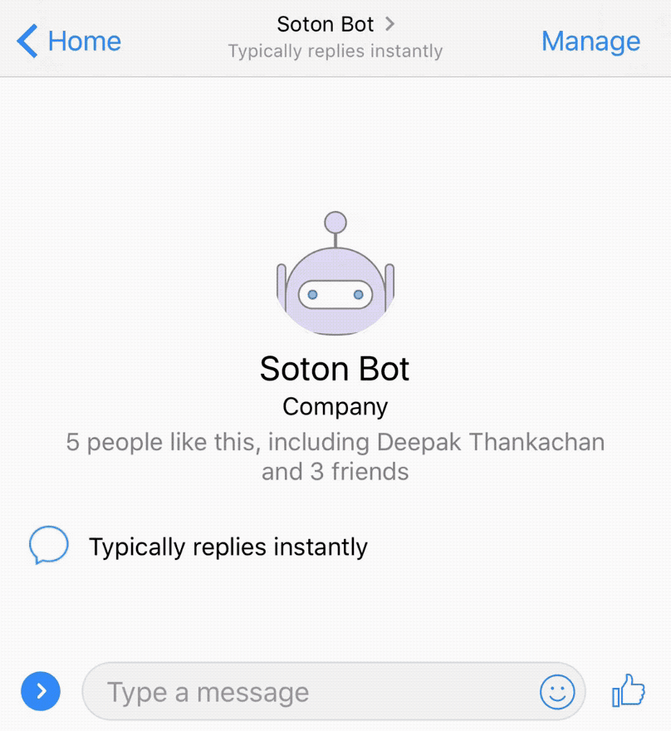
ODI Group 1
SOTON BOT

Slide 2

What is SOTON BOT?
Buddy on Messenger you talk to using natural language to help you find rooms to book, buses to take, places to eat and more!
Facebook Messenger API
Natural Language Processing API.AI
Open Data

Slide 3
Why SOTON BOT?
Effortless information retrieval
Messenger has highest adoption rate
Personalized, intelligent responses
No more using 5 different websites that many don't even know exist!

Slide 4
What can SOTON BOT do?
Find Buses
Find Essentials
Locate Places To Eat
Access Room Details
Discover Campus Buildings
Where is the nearest bus stop?
What bus takes me to civic centre?
Where can I get a U1A?
How can I get to civic centre?

Slide 5
What can SOTON BOT do?
Find Buses
Find Essentials
Locate Places To Eat
Access Room Details
Discover Campus Buildings
Where can I get vaccination?
Car parking
Where can I get some alcohol?
Where is an atm?

Slide 6
What can SOTON BOT do?
Find Buses
Find Essentials
Locate Places To Eat
Access Room Details
Discover Campus Buildings
Where can I get some coffee?
Where can I find some pizza?
Food please!

Slide 7
What can SOTON BOT do?
Find Buses
Find Essentials
Locate Places To Eat
Access Room Details
Discover Campus Buildings
Find me a room tomorrow
Is there a free room Monday 3pm?
Find a free room next week Tuesday?

Slide 8
What can SOTON BOT do?
Find Buses
Find Essentials
Locate Places To Eat
Access Room Details
Discover Campus Buildings
Where is building 32?
Where can I find building 7?

Slide 9
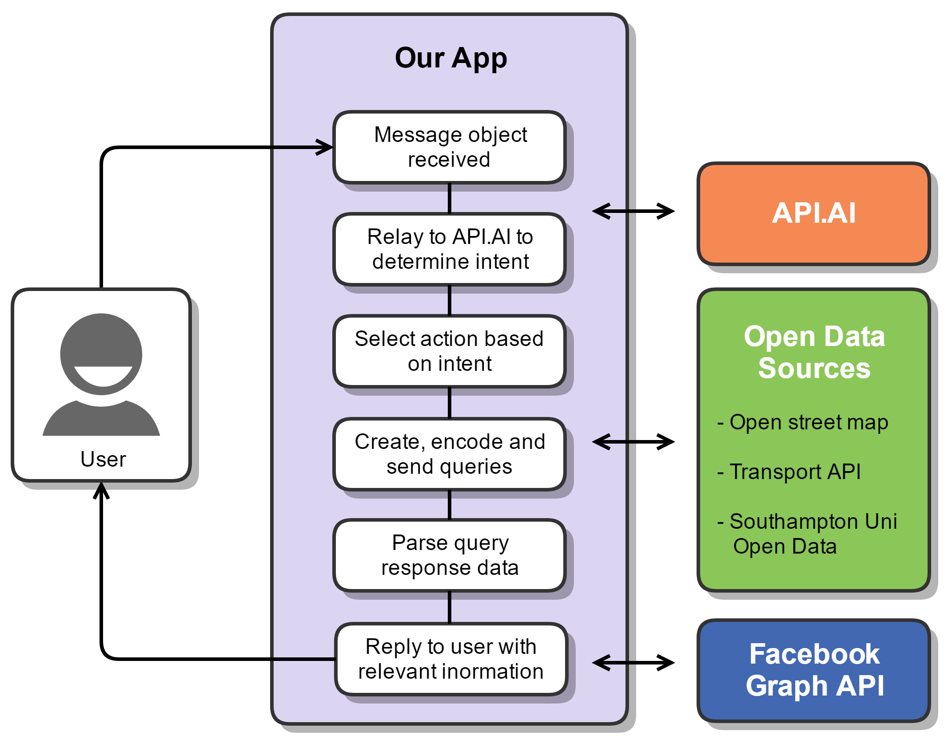
How?

Slide 10
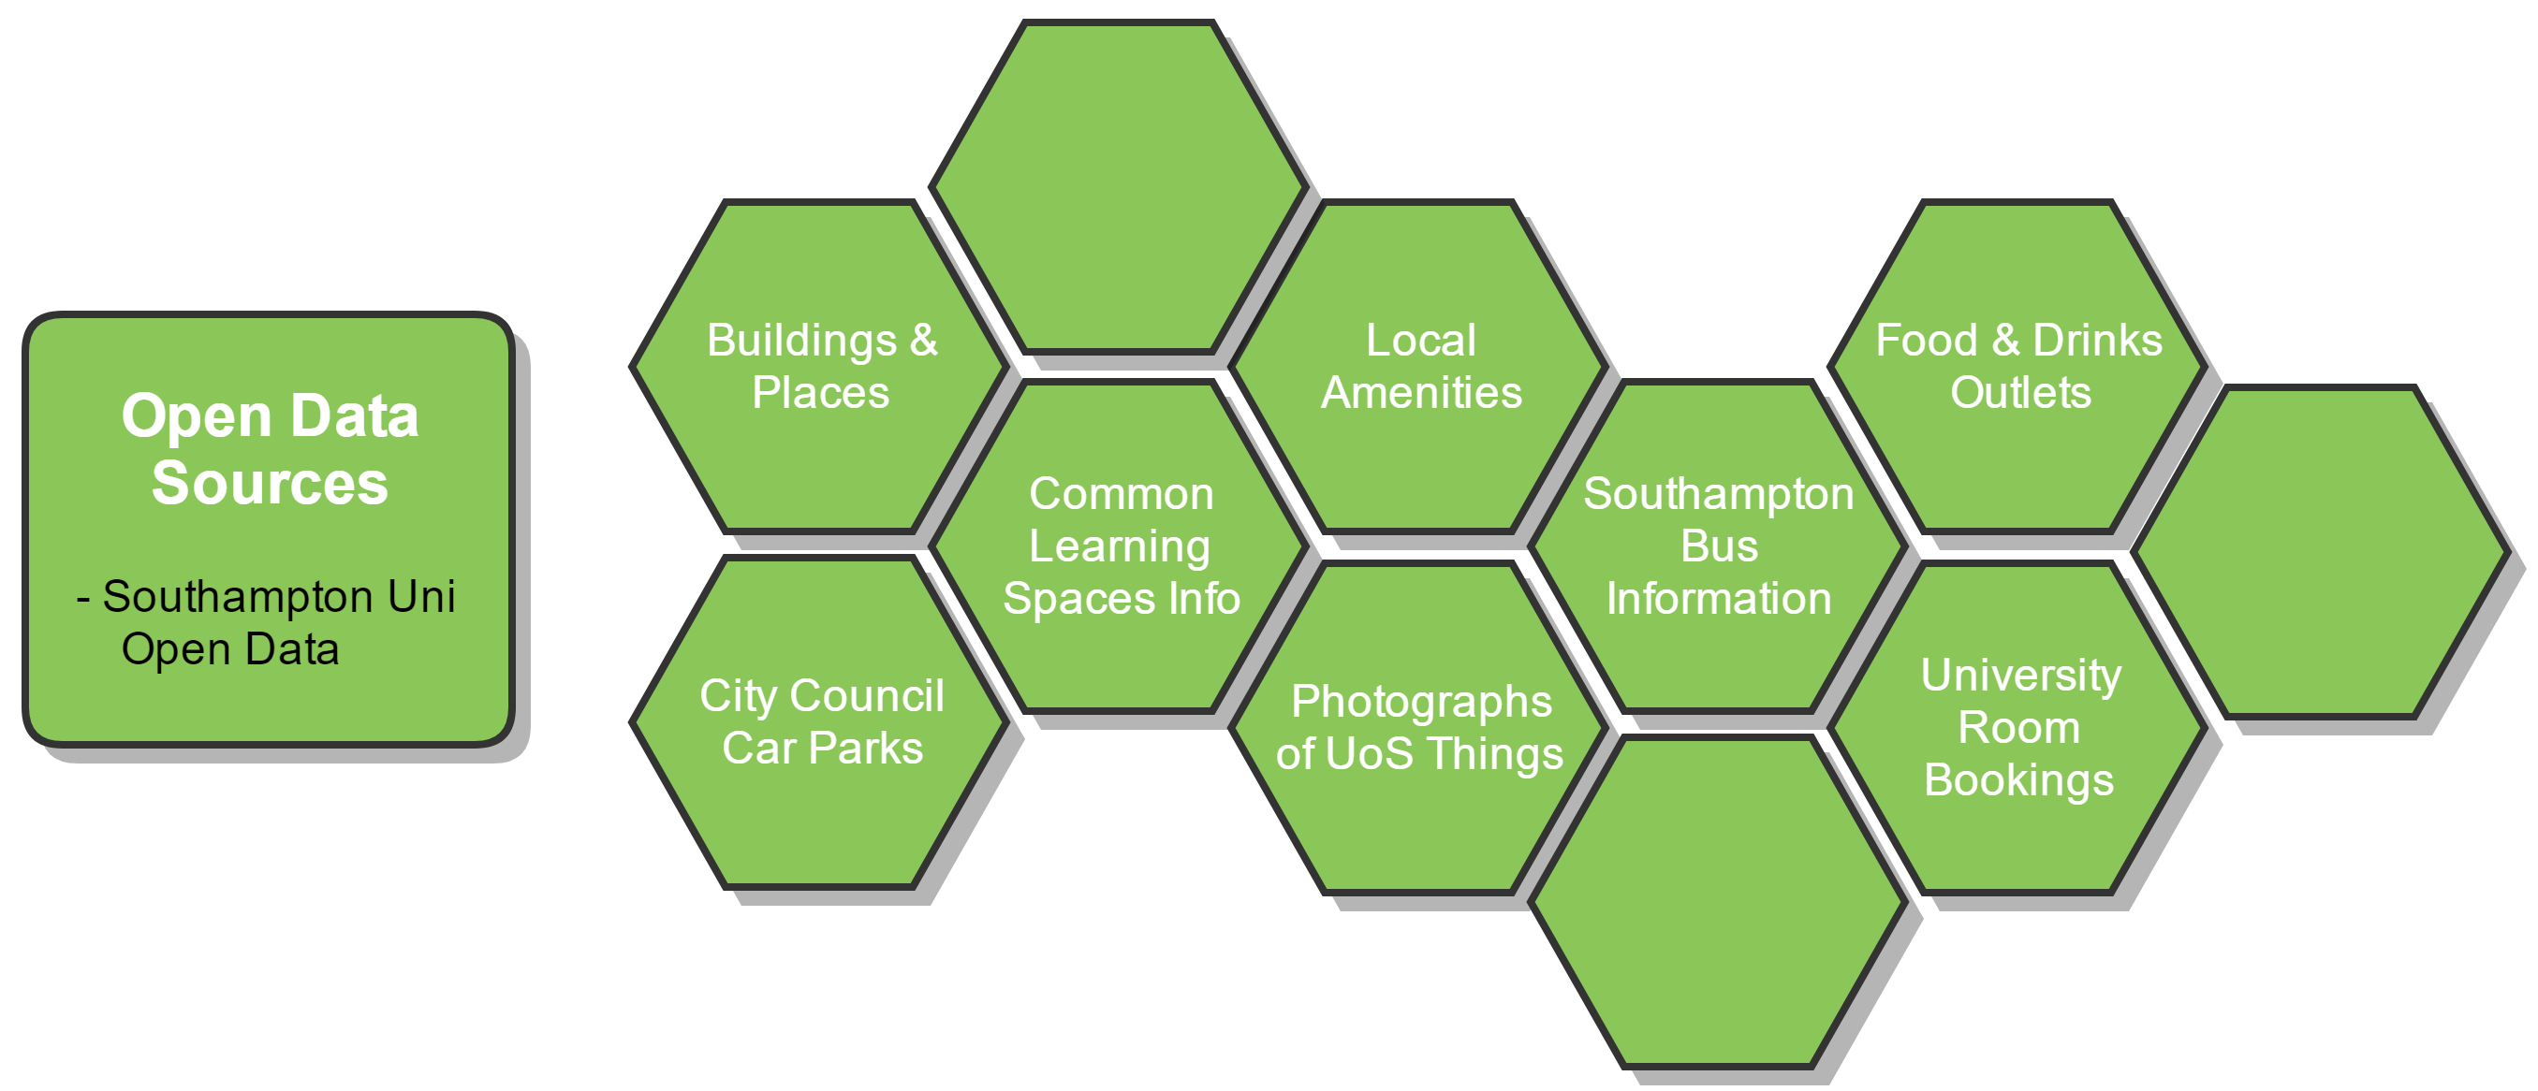
Southampton Open Data
Notes:
These are the different datasets which feed data into our application. For example we have
Southampton bus information
Building and places
Food and drinks outlets
University room booking
University of Southampton hosts all this data as one big triple store. We query their end point using SPARQL to retrieve the data.
We used 2 external open data sources; Open Street Map and Transport API
Open Street map is open data plus free. It allowed us to give visuals on locations of things.
Transport API on the other hand is paid, but there is a free quote which we are using it find a bus stop for a given geographic location.

Slide 11
More on Soton Bot
Use it out of the box using data source with an endpoint.
Mix and match your choice of technology for your business –
Slack, Skype, etc.
Wit.ai, Lex etc.
Any data service (open or not)
Other languages can also be supported

Slide 12
Commercially
Save money by better utilizing your data and streamlining the delivery to the users
Make money by selling the platform, helping to migrate data, build solutions using the platform

Slide 13
Questions?

